Slide 1
Simulation of subjects in solo fitting with Q learning model
Aim of the simulation: Getting the range of fitted parameters (learning rate and behavioral temperature)
For fast and slow learners

Slide 2

Method: How I defined learning speed for each simulated subject?
There is a parameter in the code named:
It governs the time is needed that a subject goes from random choice from (1,2) toward more selecting the option that leads to value 2.

Slide 3
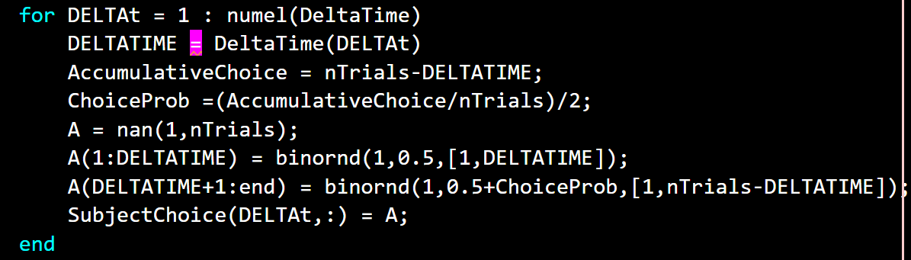
How I generate the choices for each subject?
Each choice is generated by random binary generator with specific probability favoring more choices toward reward value 2

Slide 4
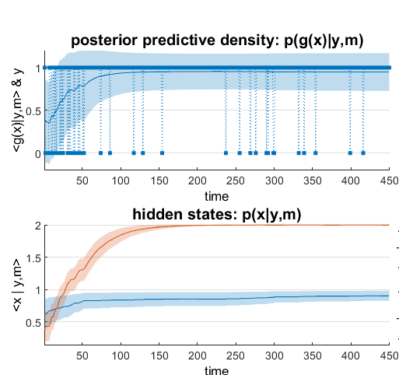
Sanity check: choice profile of different learners

Slide 5
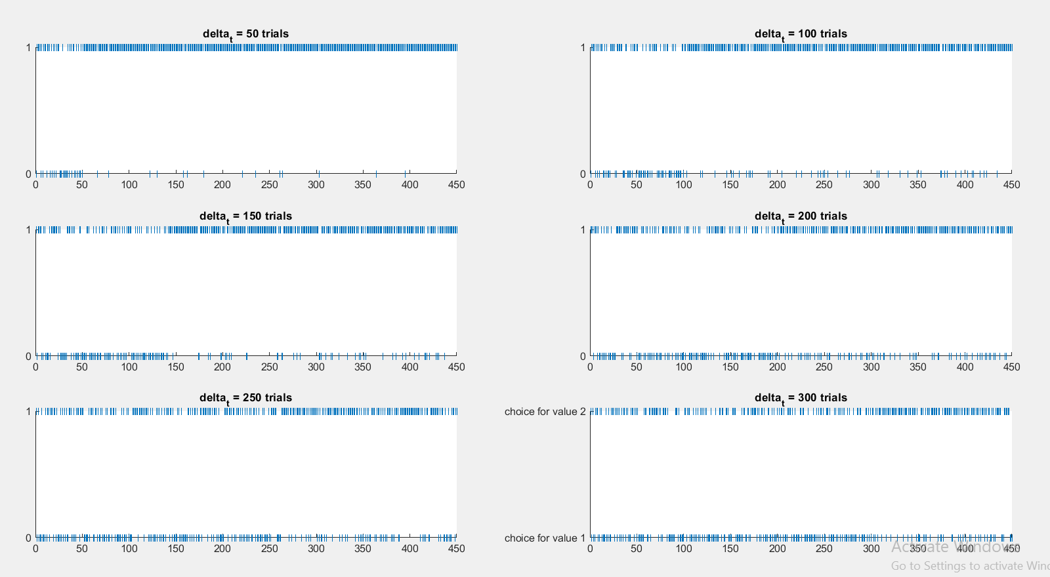

Slide 6
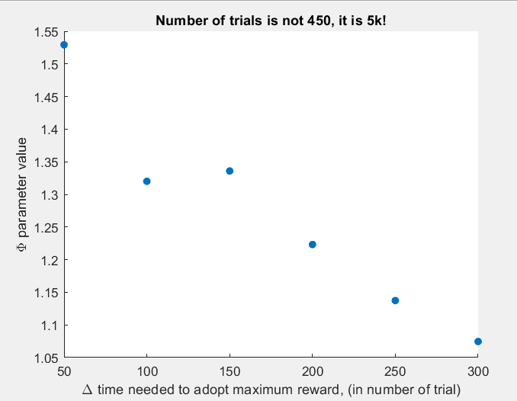
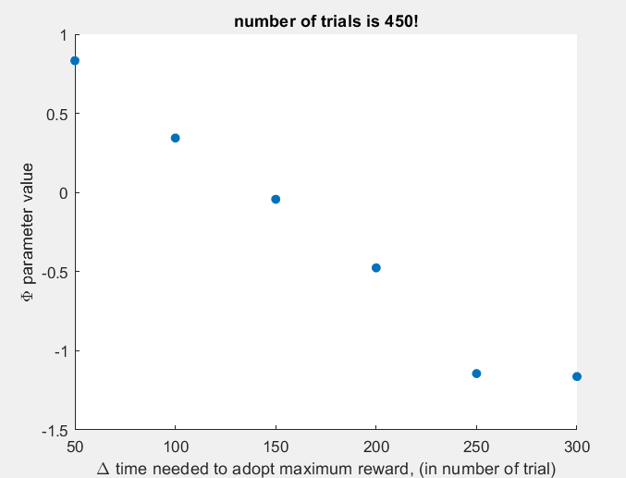
Results: Behavioral temperature parameter

Slide 7
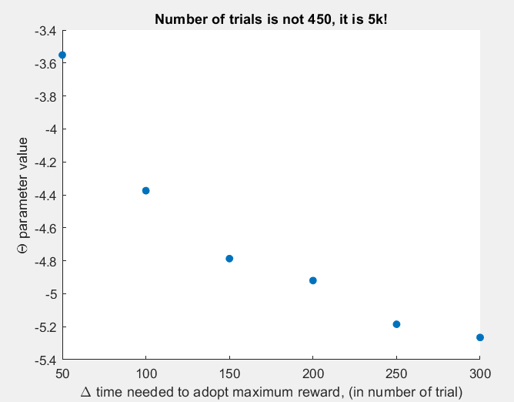
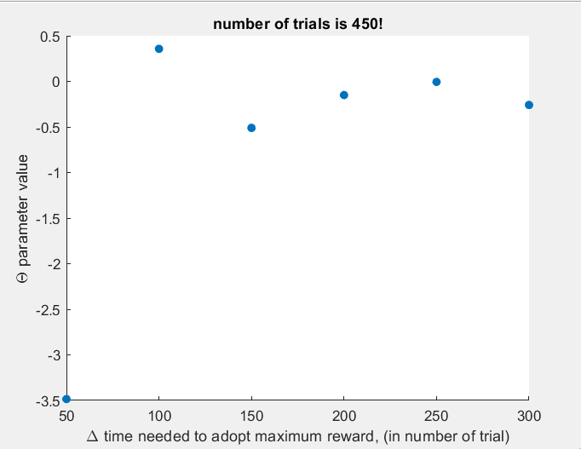
Results: Learning rate parameter
Question: What does it mean to have a NEGATIVE evolution parameter in Q learning?

Slide 8
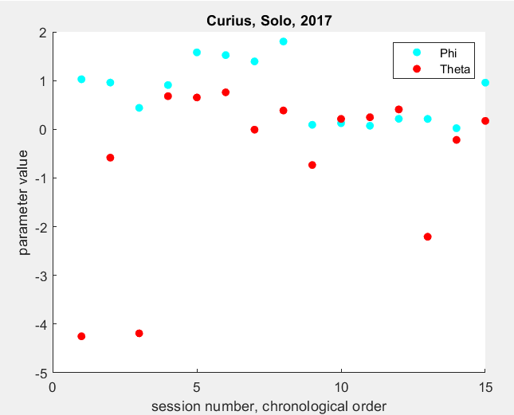
Real data is inside the range?

Slide 9
Igor’s comments and suggestions
Comments:
Parameters weren’t reported correctly, they had to be converted.
Parameters got converted:

Slide 10
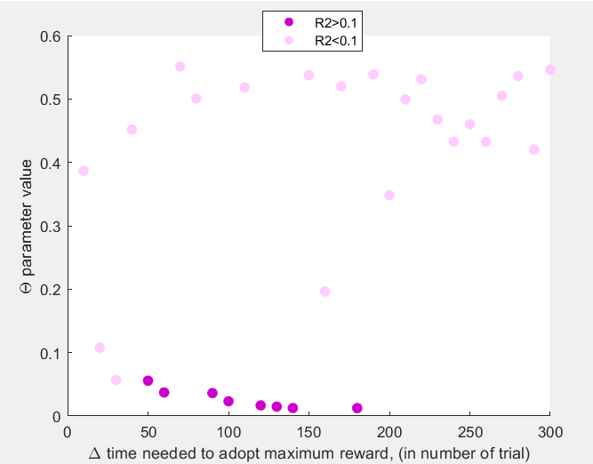
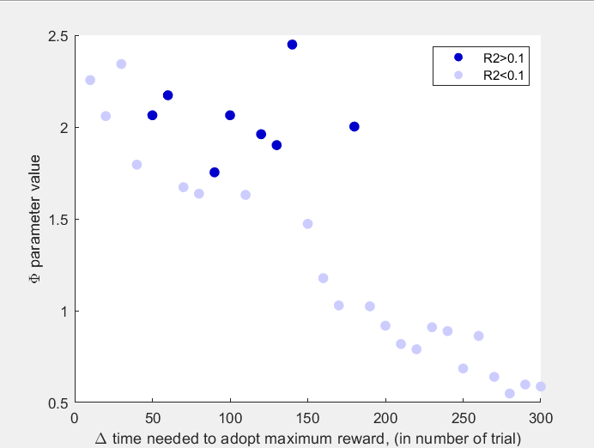
Igor’s comments and suggestions
Show parameters with different colors based on R2 value( quality of the fit) to see if the outliers are bc of bad fitting.
R2 is only informative for ‘’Theta goodness of fit’’

Slide 11
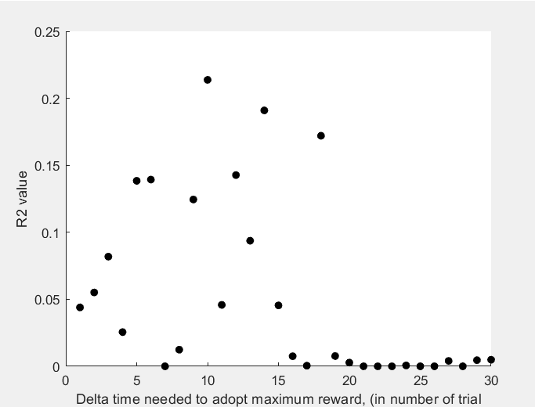
Sahra: How is the quality of the fit distributed among the speed of learning?

Slide 12
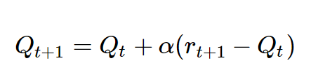

Sahra: Let’s try Q learning fitting with a very accurate but heavily computational method
I wrote three functins based on these equations:
1) Q learning function:
We can calculate the hidden value of each option
Trial by trial based on the reward that the subject received on each trial.
The initial value is always 0.5

Slide 13
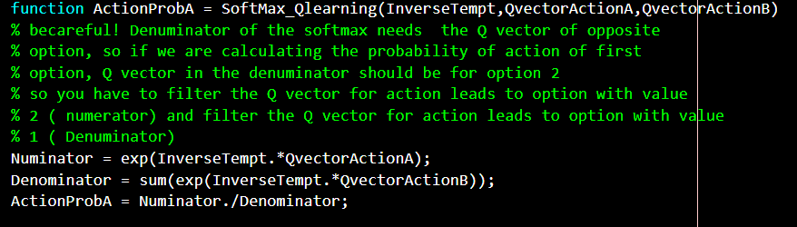
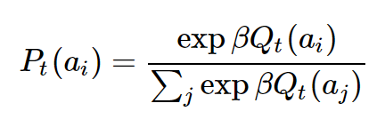
2) Softmax function: this function calculate probability of choice based on hidden states:
3) A loss function which calculates the distance between ‘’observed choice’’ and ‘’probability of the choice’’. The loss function is ‘’cross entropy’’ which extract the best fitted parameters in the minima.

Slide 14

Then we create a range for each parameter ( learning rate and reverse temperature), try each element of the range to calculate probability of the choices and then cross-entropy loss. The best parameter has the minimum loss.

Slide 15
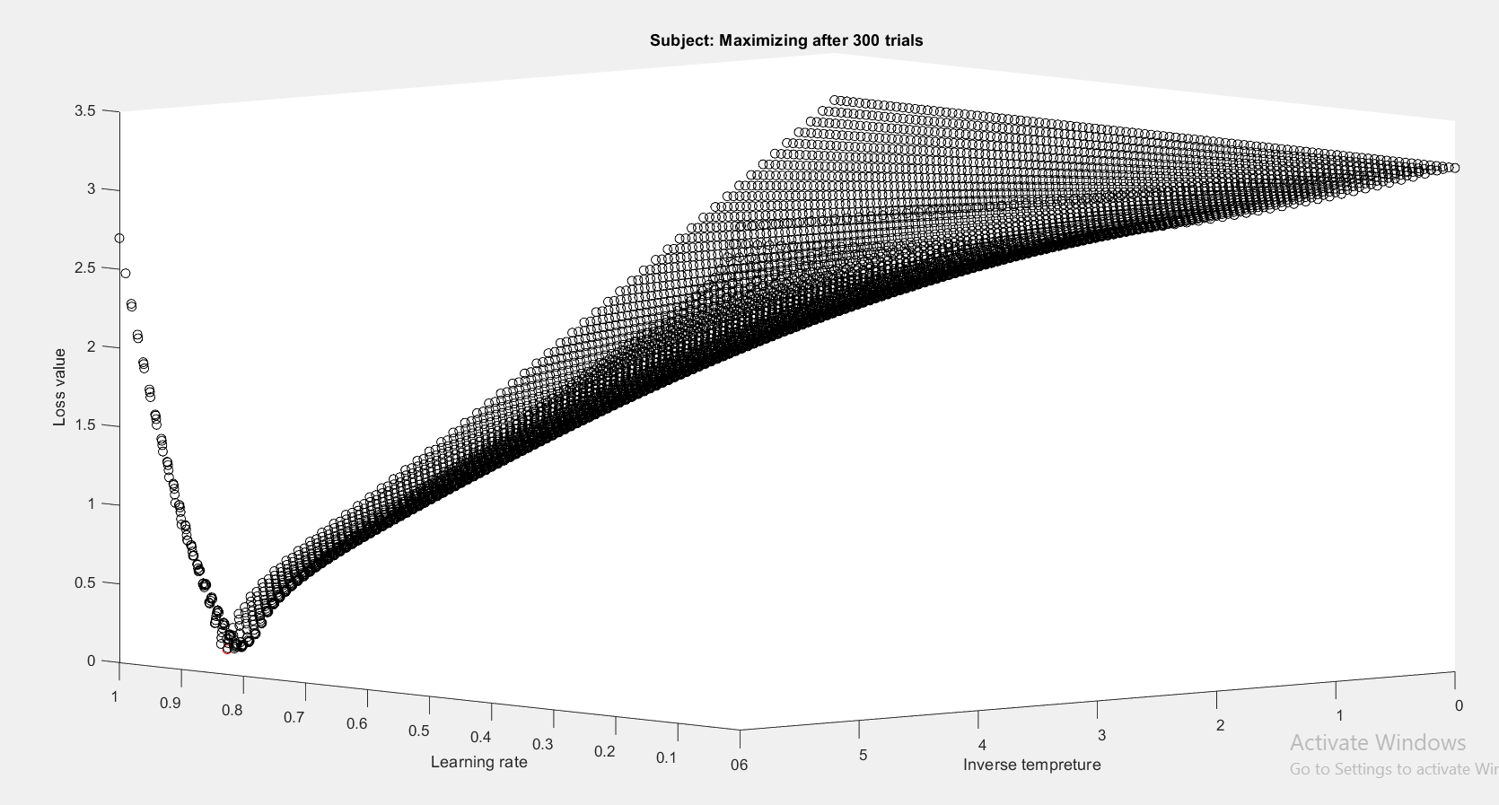
Topography of the loss function for two free parameters: learning rate and inverse temperature Minimum Loss Value = 0.0421

Slide 16
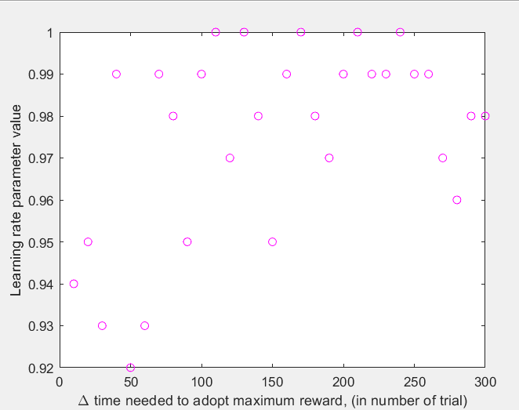
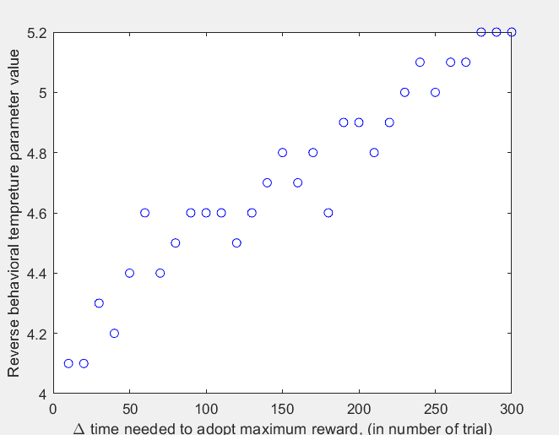
Results
With this brute force method, we see that time of the learning, has no effect on learning rate and learning rate is always near 1 ( probability of picking reward 2, is always 0.8 after learning) but there is a linear relationship between reverse behavioral temperature and time of the learning, (later learning, more exploration)

